Slide 1
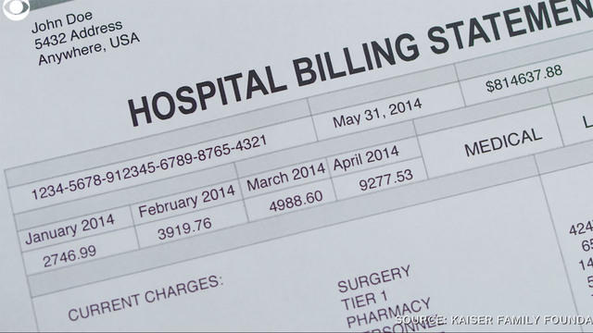
How much could your medical bill be?
General Assembly
Data Science Capstone Project
By: Zhe Zheng (Tony)
tonyzheng987@gmail.com

Slide 2
Motivation
American healthcare is known for its expensiveness, but how expensive? How much should we be expecting?
How much should we be expecting if our health insurance decided not to cover us?
I was a “victim of visiting a doctor’s office without insurance” 18 years ago for a generic cold
Witnessed someone paid more than $1,000 when working in a pharmacy out of pocket
To predict how much a person could be paying for their hospital bill

Slide 3
Data Source
Data sourced from Brett Lantz, the Director of Data Science & Decision Support from the University of Michigan
It is open sourced in his GitHub and in Kaggle for educational purposes

Slide 4
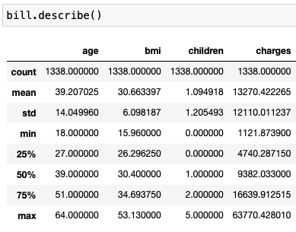
Introduction
These patient records were collected all over the US
The patients are 18 – 64 years old adults

Slide 5
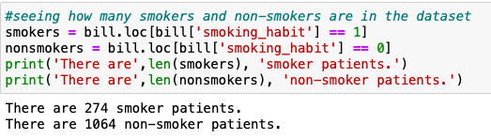
Introduction
Dataset might be skewed to non-smokers and people with BMI>30, because there are more non-smokers than smokers in the US
14% of US adults are smokers in 2019 according to CDC

Slide 6
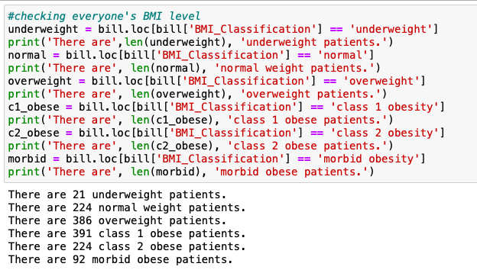
Patients’ BMI classes
More than half of the patients are obese

Slide 7
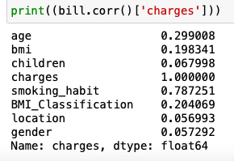
Exploratory Data Analysis
Among the 1338 patients
676 male, 662 female
364 of them are from SE, 325 from NW, 325 from SW, 324 from NE
Highest correlation to the charges is smoking status, age and BMI

Slide 8
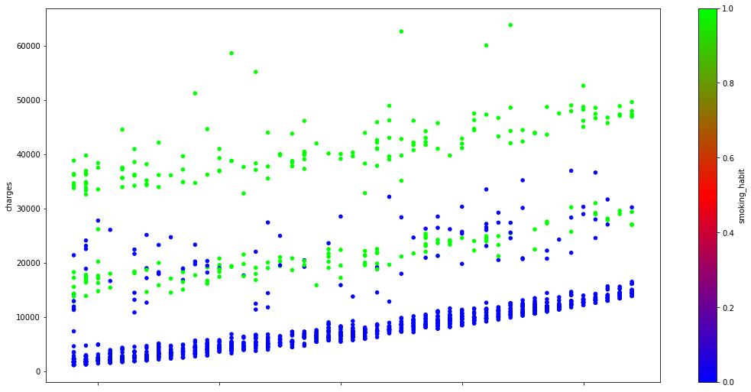
How much did each patients paid
Age: 18-64
Notes:
X axis is age from 18 to 64. Y axis is how much the cost, and blue are non-smokers, and greens are smokers. As seen, there are three blobs

Slide 9
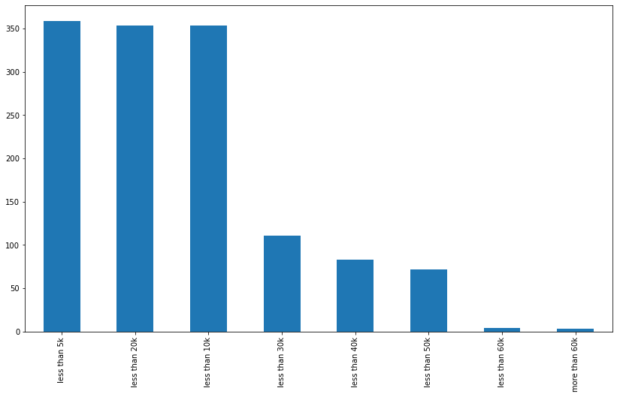
Sorry, the graph earlier was a bit misleading
The non-smokers were stacking together in the bottom thus can’t see them well, here’s are how much do each patients
Most patients spent less than $20,000
Notes:
More than 75% of the dots belong under 20k

Slide 10
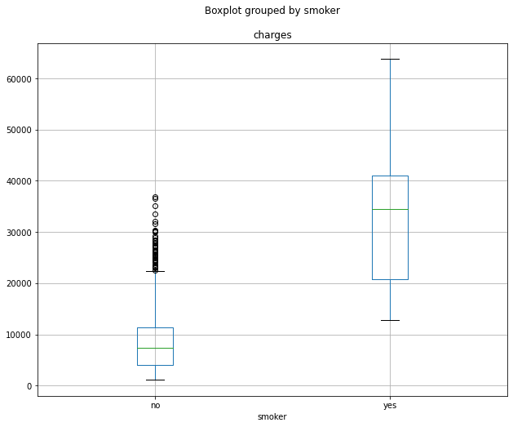
Smoker vs non-smokers in boxplot
Notes:
In average, smokers pay 4.69 more than non-smokers in medical bills

Slide 11
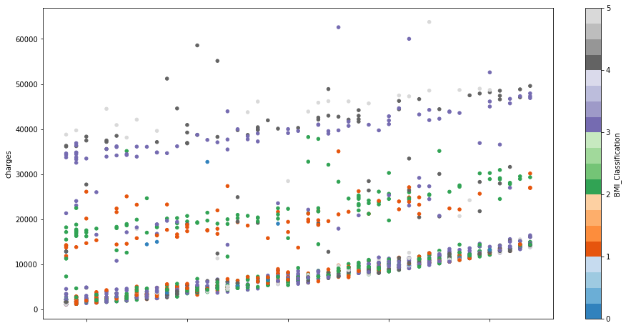
Charges vs age but the color represents BMI levels
Notes:
In the lowest and the middle blob, they have all types of colors, but in the upper blob, mostly only consists the obese categories

Slide 12
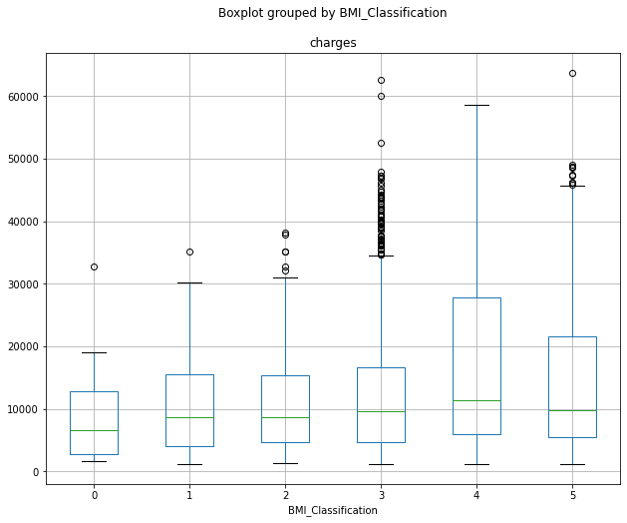
Cost per hospital visit by BMI Classification

Slide 13
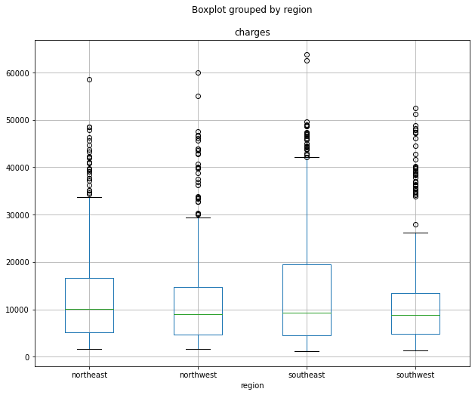
How much do each locations pay?
Notes:
Here are some factors that don’t matter that much

Slide 14
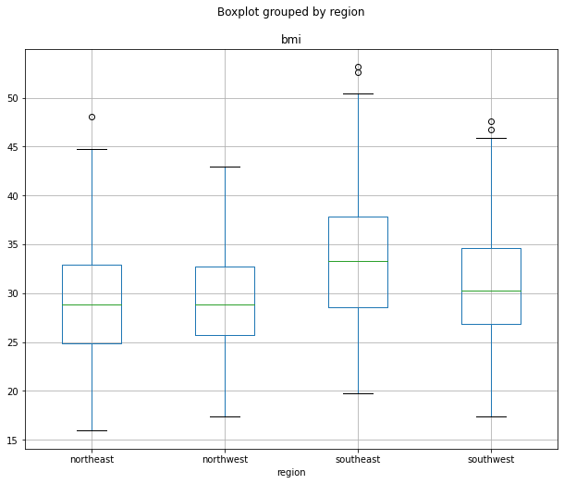
BMI by region
Notes:
SE seems to have higher BMI generally in general, but we are looking for the charges, this data might be useful in another presentation

Slide 15
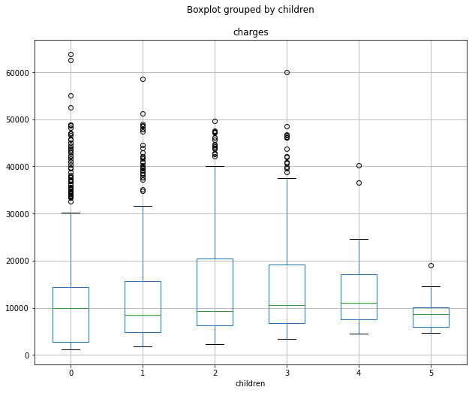
Does having kids effect the medical bill?
Notes:
It seems like to have a correlation of having 4 or more kids can reduce the medical bill. However, hospitals don’t give discounts just because the patients have more kids. There aren’t many people with 4 or 5 kids

Slide 16
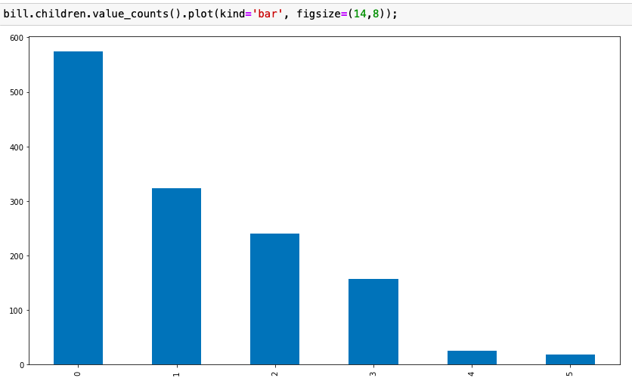
How many children do the patients have

Slide 17
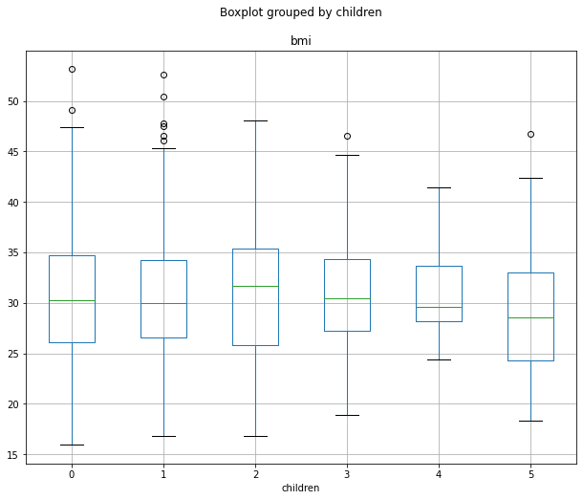
Patients’ BMI vs how many children they have
Notes:
Out of topic, do stress level from having children or financial responsibilities impact the BMI? It just too few sample for people with 3-5 kids

Slide 18
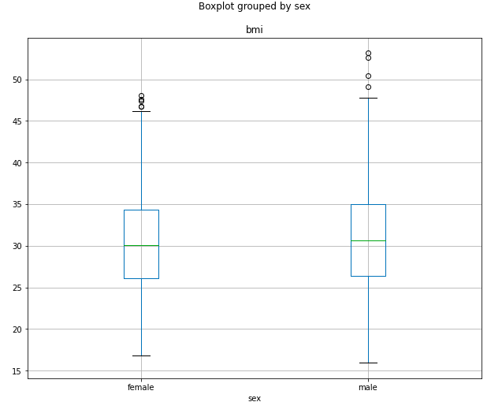
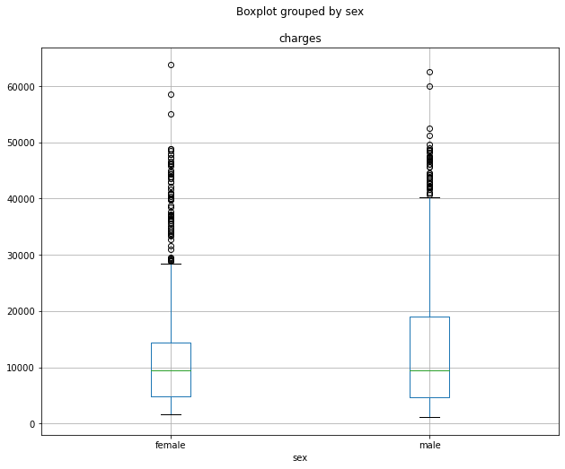
Gender vs BMI and the medical bill
Notes:
“Gender equality” under hospital bills, similar BMI level and similar charges makes gender an irrelevant factor

Slide 19
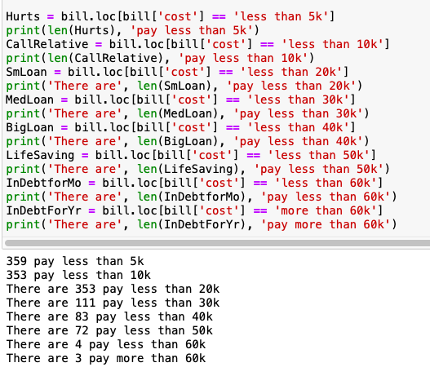
Modeling
I made the payment prediction into 4 categories with similar quantities of data
< $5,000
$5,000 <= n < $10,000
$10,000 <= n <= $20,000
> $20,000
Applied the K-Nearest Neighbor and GridSearchCV methods to predict

Slide 20
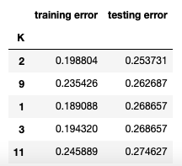

According to K-Nearest Neighbor
22 years old non-smoker with a normal BMI going to pay …
Less than $5,000
27 years old smoker, with class 2 obesity is going to pay…
More than $20,000
65 years old overweight, non-smoker, is going to pay …
Between $10,000 and $20,000
46 years old underweight smoker is going to pay …
Between $5,000 and $10,000
I am going to pay less than $5,000 according to my prediction

Slide 21
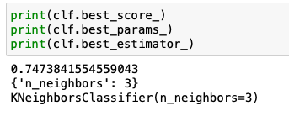
According to GridSearchCV
22 years old non-smoker with a normal BMI going to pay …
Less than $5,000
27 years old smoker, with class 2 obesity is going to pay…
More than $20,000
65 years old overweight, non-smoker, is going to pay …
Between $10,000 and $20,000
46 years old underweight smoker is going to pay …
Between $5,000 and $10,000
I am going to pay less than $5,000 according to my prediction
Prediction results are the same but different Knn number

Slide 22
Conclusion
Smoking and high BMI can increase your medical bill, age can also be a factor that increases the bill steadily
There are too few correlated factors
It would be better if included factors like medical history like cholesterol and blood sugar level, blood pressure, any chronic illnesses…
We all know the reason for hospitalization and the number of lab tests will determine the bill the most
More sample is always better

Slide 23
Limitation
Don’t take these numbers and prediction in face value because the the prediction were merely based on 3 factors
There are only 1.3k row, it set the limit based on the min and max
No way to know which hospital, location of hospital might charge differently
Quality of service might not be the same
The data is at least 6 years old, the number may not reflect the current reality due to inflation, or the cost might change due to more efficient technology

